Slide 1

Project 2: Employee Attrition
By Matt Macrides

Slide 2
Introduction
For this project, I want to see how well I can predict employee attrition (turnover) and employee performance, discover which model predicts the best, and find out which variables have the most power.
We will compare the accuracy between Random Forest, XGBoost, Gradient Boosting, SVM, Logistic Regression, and Naïve Bayes.

Slide 3
Pre-Processing
First, I dropped several columns that had the same value for all records (Ex: Standard Hours = 40)
Then, I converted categorical text variables into dummy variables for modeling. For instance, for Gender, I mapped Male to 1 and Female to 0. I did this for attrition, businesstravel, maritalstatus, department, jobrole, educationfield and overtime variables as well. An example is shown below.

Slide 4
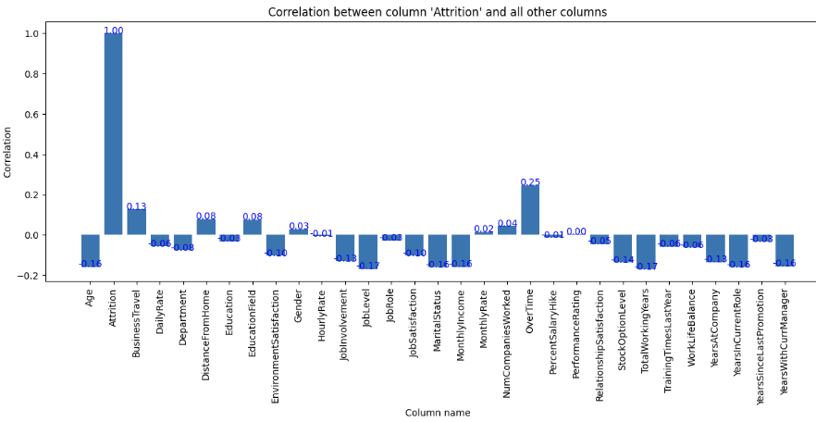
Correlations with Employee Attrition
Nothing really stands out. The largest absolute correlation is OverTime at 0.25.

Slide 5
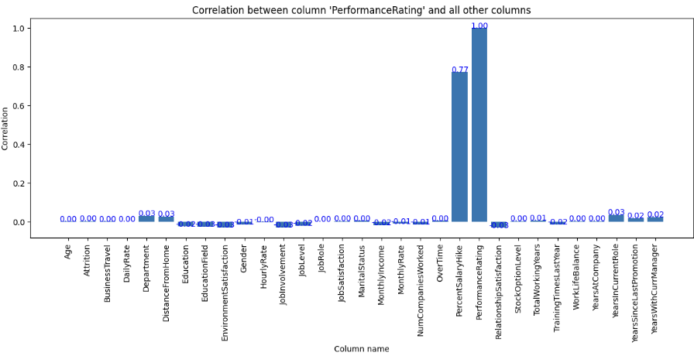
Correlations with Employee Performance
Looking at this chart, we can see that variables have less absolute correlation besides PercentSalaryHike when compared to the slide prior. PercentSalaryHike has a positive correlation of 0.77. This makes sense that salary and performance would be correlated. Let’s test for significance in the next slide.

Slide 6
Employee Performance and Attrition Distributions
Nearing the modeling phase, I was curious how the target variables were distributed.
Performance:
3: 85%
4: 15%
Attrition:
0: 84%
1: 16%
Because our distributions are imbalanced, we will focus on AUC rather than accuracy

Slide 7
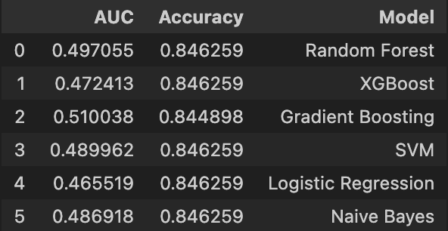
Employee Performance Model
I decided to remove PercentSalaryHike because it happens after the fact of a good performance. Also, including it would make the model 100% accurate. Here are the results:
AUC is about 50% which means it does not perform any better than random chance. Therefore, I think it’s safe to assume that every variable but PercentSalaryHike is just noise for performance.

Slide 8
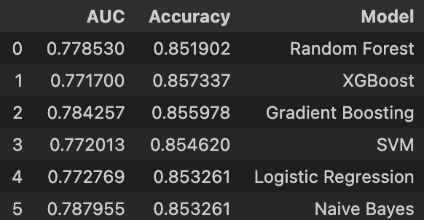
Employee Attrition Model
Moving onto Attrition, we do see some more interesting results shown below:
On average, the AUC is around 78%

Slide 9
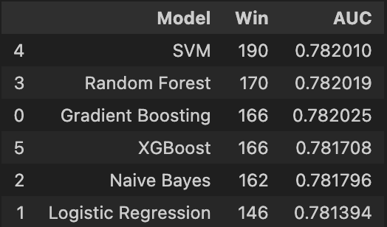
Employee Attrition – Winner Function
I decided to create a winner function to iterate through each model and select the winner with the highest AUC. Let’s do this for 1000 occurrences. Here are the results:
The results are interesting because even though SVM won the most times, the largest difference in average AUC scores is .0007 or .07% which tells me that all models are comparable.

Slide 10
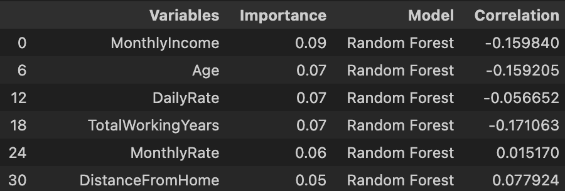
Employee Attrition – Feature Importance and Correlations
Let’s look at the feature importance of a model. I am displaying Random Forest below but I made sure to look over each model. I found that MonthlyIncome and Age are consistently the highest feature importance as well as a relatively strong correlation compared to the other features. Both of these correlations are negative indicating that greater employee ages and income are associated with lower attrition.

Slide 11
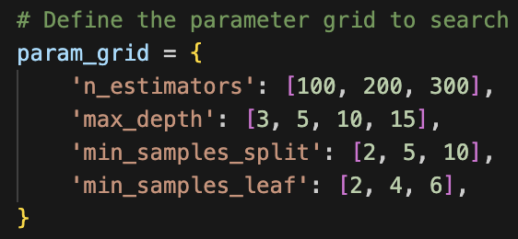
Adding Hyperparameters - Random Forest
The accuracy of the model increased from 78.2% -> 78.7%. This is minimal. I used gridsearch to find the best parameters. The parameters are shown below:

Slide 12
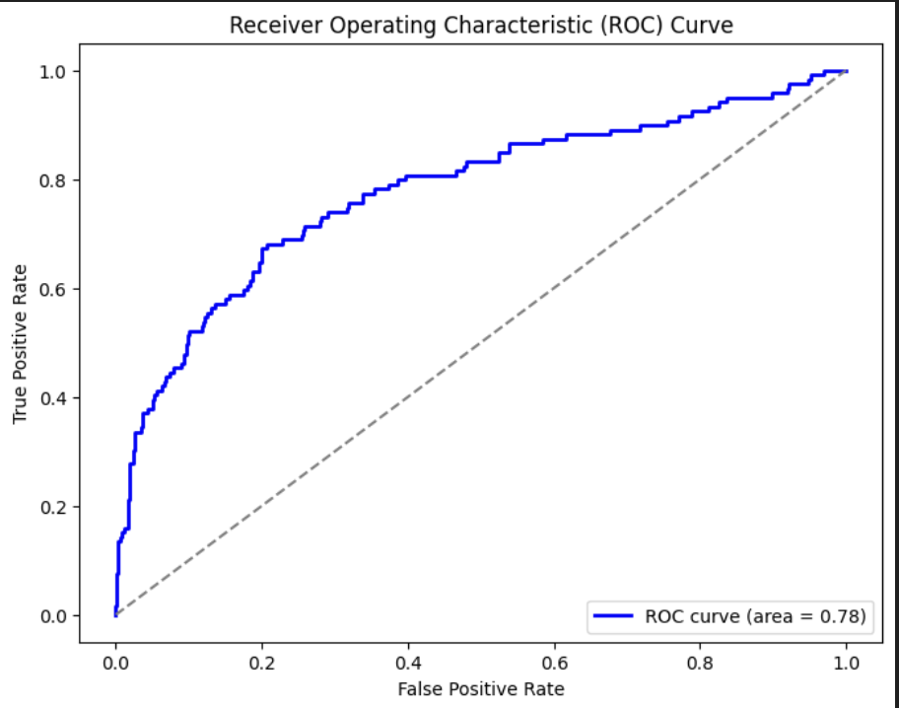
AUC Curve of the tuned RF Model
Here is the AUC curve of the tuned RF model. As you can see, it performs better than random chance.

Slide 13
Conclusion
Employee Performance
The only variable that had a correlation greater than 0.035 was PercentSalaryHike that had a correlation of 0.77
100% AUC when including percentsalaryhike and 50% without
Employee Attrition
Attrition model is 78.2% accurate for all models (plus-minus .07%)
Tuned Attrition model has an 0.05% increased AUC score

